Slide 1

WAY TO ENTERPRISE
React JS
VTI ACADEMY
Author: duy.nguyenngoc1@vti.com.vn
March 2020

Slide 2
Agenda
Setup NodeJS
Setup TypeScript
Setup Visual Studio Code
Copyright © VTI Academy All Rights Reserved

Slide 3
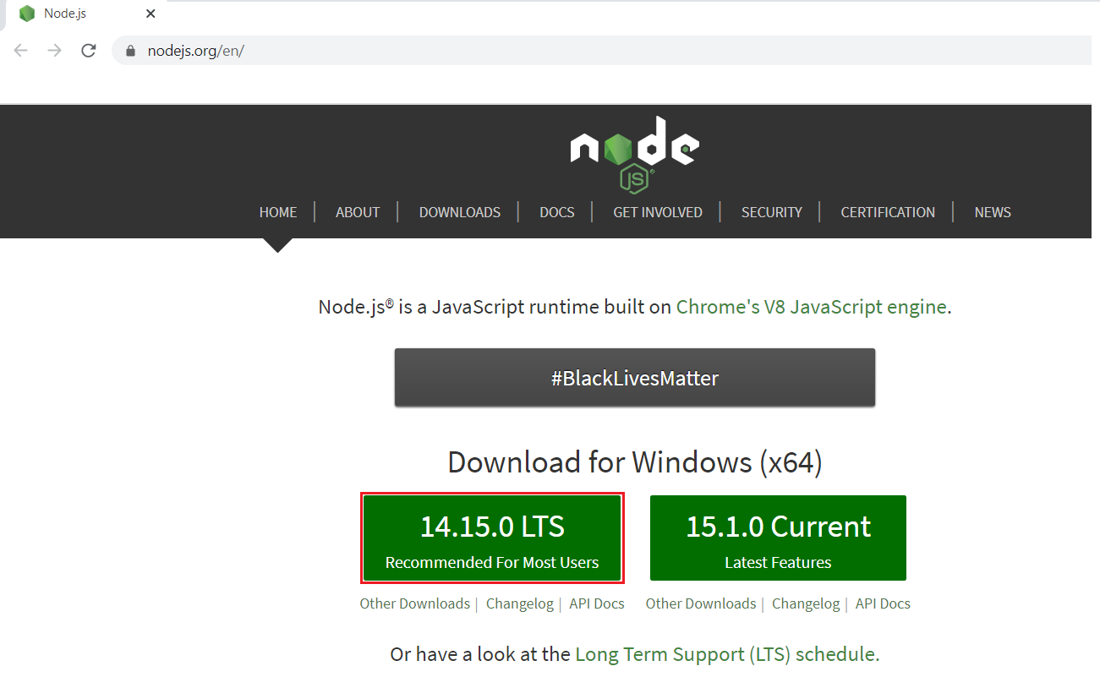
Step 1: Download NodeJS
https://nodejs.org/

Slide 4
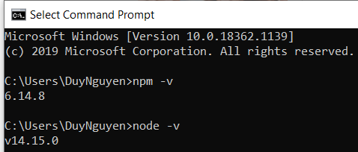
Step 1: Download NodeJS
npm -v
node -v

Slide 5
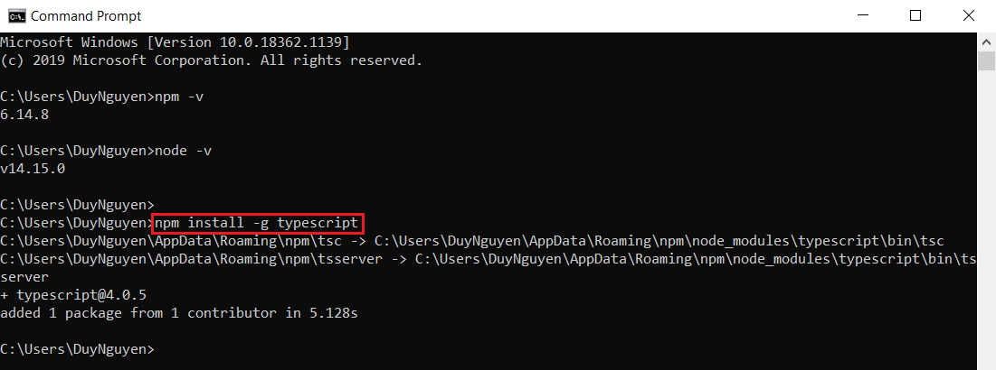
Step 2: Install TypeScript
npm install -g typescript

Slide 6
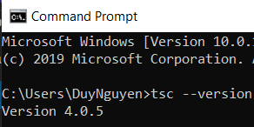
Step 2: Install TypeScript
tsc --version

Slide 7
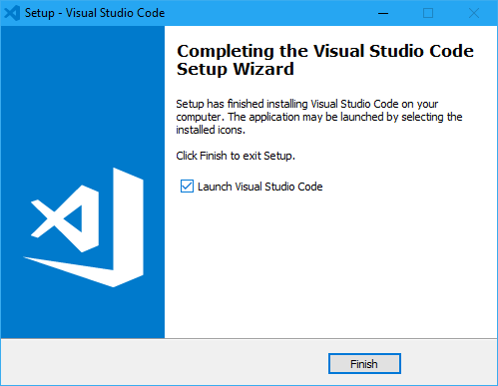
Step 3: Visual Studio Code
https://code.visualstudio.com/

Slide 8
Q & A
Copyright © VTI Academy All Rights Reserved

